Slide 1



High Performance Computing
with Digital Research Alliance of Canada
Presented by :
Lamiae El Mendili
Olivier Stocker
Reza Mahmoudi Kouhi

Slide 2
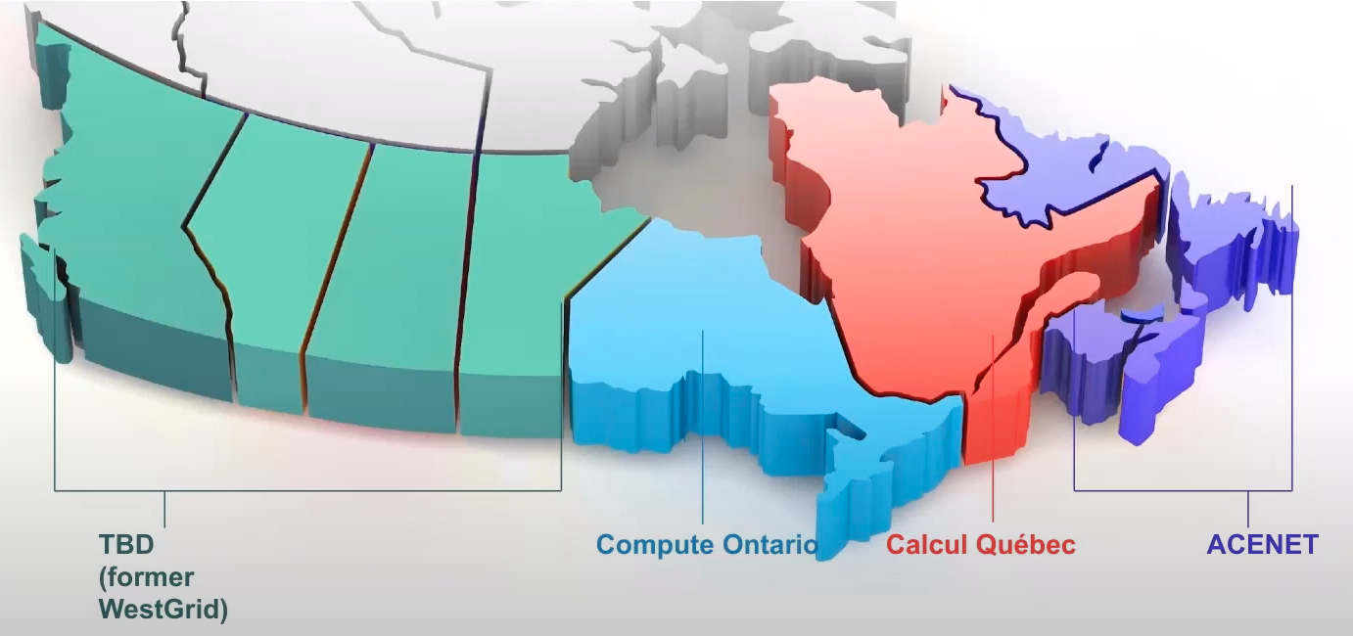
What is the Alliance ?
DRAC (former Compute Canada) is Canada's national high-performance computing (HPC) system

Slide 3
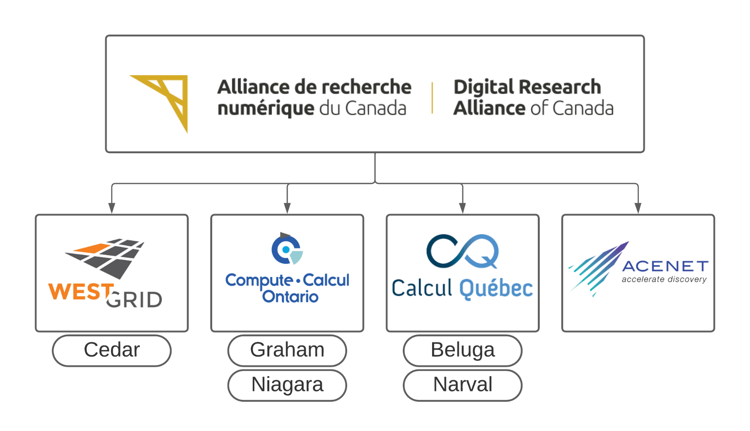

Slide 4

Tutorial objectives
Getting started with CC
Therory and practice mixed together
From account creation to Job efficiency evaluation

Slide 5
Summary
Accessing HPC
Data managment
Computing
Ressource usage
Others

Slide 6
Detailed summary
Accessing HPC
Data managment
Computing
Ressource usage
Others
Global picture
Account creation
Connexion
File structure
Data transfert
Running jobs
Setting up coding environnement
Automate jobs runs
Jobs priority
Job efficiency
Coding astuces
NEED MORE POWER !
How to call for help : CC support

Slide 7

Services of Alliance
Services types :
HPC clusters :
beluga.computecanada.ca
cedar.computecanada.ca
graham.computecanada.ca
narval.computecanada.ca
niagara.computecanada.ca
Storage
Clouds :
arbutus.cloud.computecanada.ca
cedar.cloud.computecanada.ca
east.cloud.computecanada.ca
graham.cloud.computecanada.ca

Slide 8
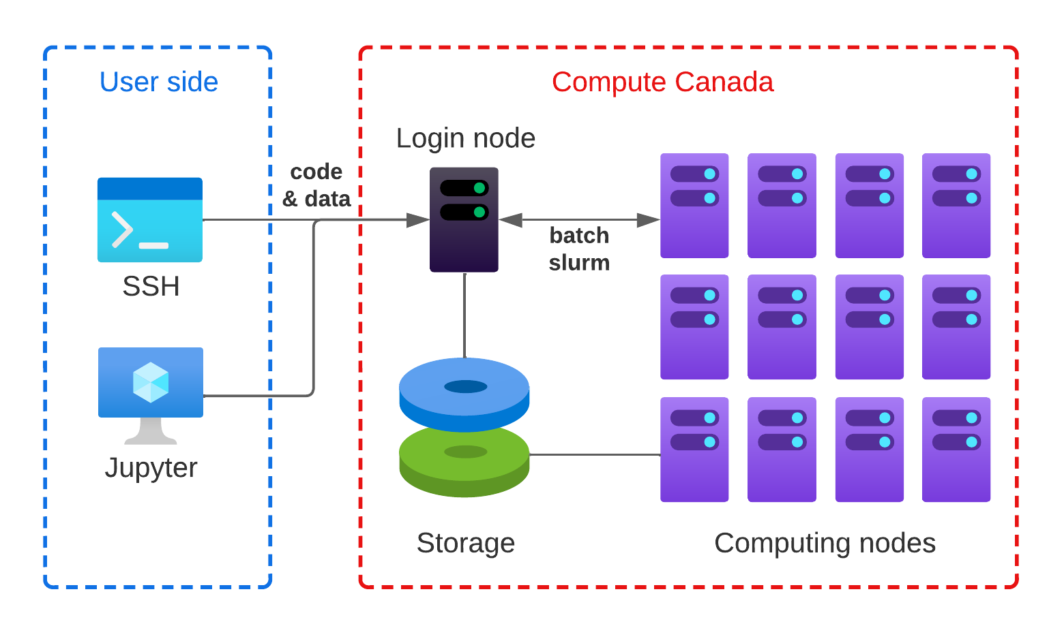
Global view of HPC clusters

Slide 9
Global view of HPC clusters
Accessing HPC
Data managment
Computing
Ressource usage
Others

Slide 10
System details
OS: 64-bit Linux
Languages: C/C++, Fortran, R, Python, Matlab/Octave, Java, Julia, CUDA…
Access to a variety of software packages
Parallel development support:
MPI, OpenMP, Pthreads, CUDA, OpenACC, OpenCL, DDT
C++: Language support for multithreading (since C++-11 standard)
Fortran: Language support for parallel programming (since 2003 standard)
Julia: Parallel processing constructs, shared and distributed objects
Data science support:
R, Python, Julia, Spark, DASK…
Batch computing via slurm

Slide 11
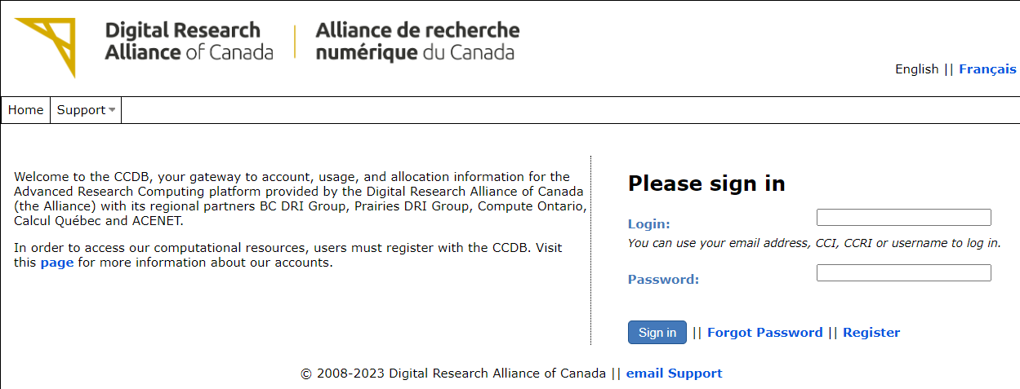
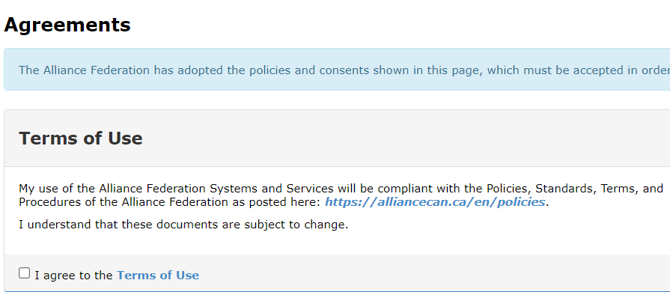
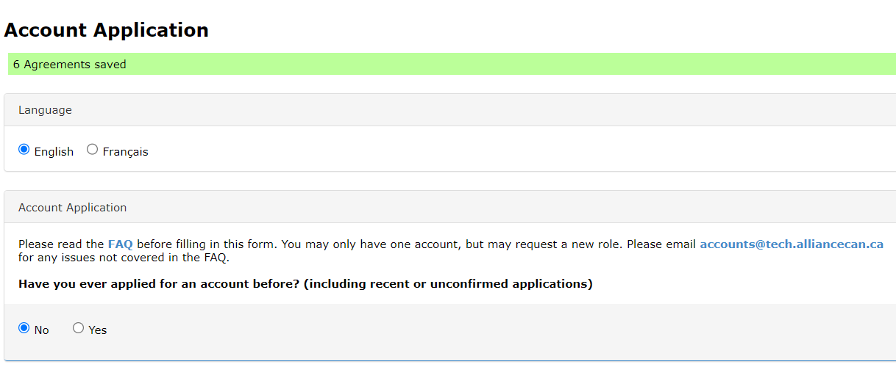
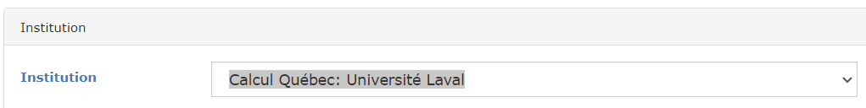

How to create an account
Ask your supervisor to create his/her account if he/she does not already have one.
Go to https://ccdb.alliancecan.ca/security/login for registration
Fill the Agreements form
Fill the Account Application form
For institution choose: Calcul Québec: Université Laval
Ask your supervisor to provide you his CCRI code

Slide 12
Connecting to Compute Canada Clusters
Registration
Faculty member registers in the Compute Canada Database (CCDB)
https://ccdb.alliancecan.ca/security/login
Once account is approved, students can register as group members
Your compute canada credentials will be used to connect later on. They are :
Username
password
Notes:
Add a slide about guest log in

Slide 13
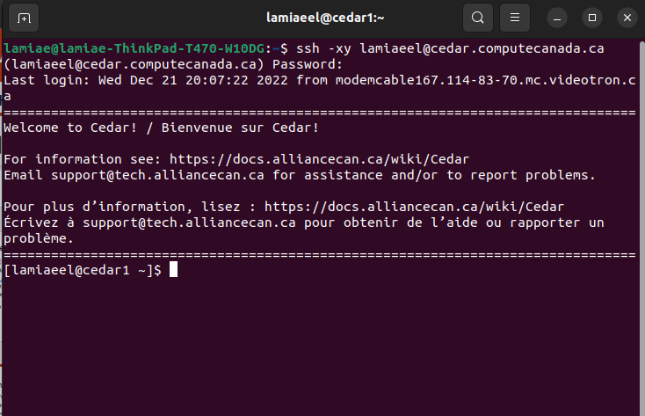
Connecting to Compute Canada Clusters
How to Connect to a cluster on Windows ?
SSH (Secure Shell) Connection:
A secure protocol for accessing remote servers and clusters.
Allows you to access the cluster's command-line interface remotely
Connect using SSH from a terminal :
Cedar: $ ssh -XY username@cedar.computecanada.ca
Graham: $ ssh -XY username@graham.computecanada.ca
Beluga: $ ssh -XY username@beluga.computecanada.ca
Niagara: $ ssh -XY username@niagara.computecanada.ca
Notes:
Typo windows

Slide 14
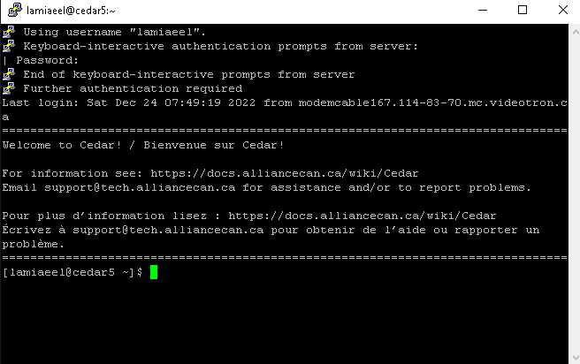
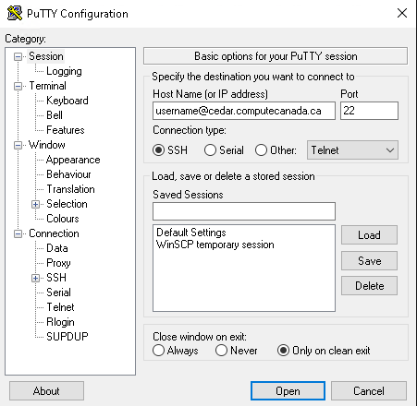
Connecting to Compute Canada Clusters
How to Connect to a cluster on Windows ?
Install the SSH client Putty : http://www.putty.org/
Add Host Name : username@cedar.computecanada.ca
You will be prompted for your password

Slide 15

Files management in CC
What are files number limit, automatic cleaning and general rules ?
Everyone has the access to the following file systems
/home: 50g, 0.5m files; backed up regularly
/project: 1T (extendable to 10T) per group, 0.5 files; backed up.
/scratch: 20T per user, 1m files, up to 100T; 2 month of life.
nearline: to store files not currently in use but may be needed later; 5k files (approx. 10T) per group. NOT available on compute nodes.
Files are not shared across systems. You need to move and copy files around as needed.
Please DO NOT store everything, remove the files no longer in the use to save space.

Slide 16
Files transfer in CC
How to transfer files from Linux ?
You can use scp or rsync :
Scp : $ scp [Options] [Target_path] [Destination_path]
Rsync : $ rsync [Options] [Target_path] [Destination_path]
Target_path : Files or directory to copy (on you local machine)
Destination_path : Where to copy the files (on the remote server)
Example : username@computecanada.ca:~/scratch/

Slide 17
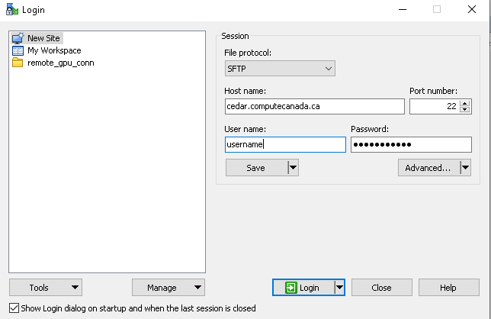
Files transfer in CC
How to transfer files from Windows ?
We can use either Winscp or Fillezilla which are popular GUI applications used for transferring files between a local computer and a remote server
Winscp :
Download WinSCP and launch it at https://winscp.net/eng/download.php
In the WinSCP login window, you'll see fields for Host name, Username, and Password. Enter the following information
Click the "Login" button to establish a connection

Slide 18
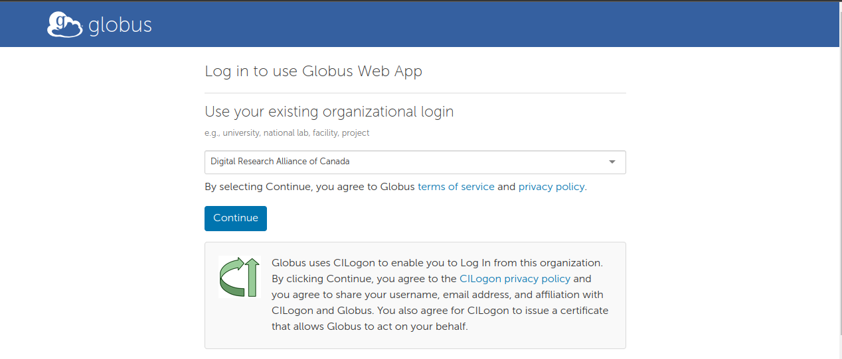
Files transfer in CC
How to transfer files using GLOBUS ?
Globus is a service for fast, reliable, and secure data transfer and usually gives the best performance and reliability
Go and login to https://www.globus.org/
Click on Use your existing organizational login

Slide 19

Launching Jobs
How to launch interactive jobs ?
These can be useful for data exploration at the command line and debugging
Launching jobs interactively on Compute Canada clusters can be done using the salloc command. This allows you to reserve computing resources for a specific period to run tasks interactively.
The basic syntax for launching an interactive job is:
$ salloc --time=[hh:mm:ss] --mem=[mem] --ntasks=[ncpu] --account=[def-someuser]

Slide 20
Loading CC modules : setup working environment
Loading modules to have access to python, GPU, etc.
module load python/3.7
module load cuda/10.2
For more: https://docs.alliancecan.ca/wiki/Available_software
Setting up the Virtual Environment:
virtualenv --no-download $SLURM_TMPDIR/test
source $SLURM_TMPDIR/test/bin/activate
Installing the libraries
pip install --no-index --upgrade pip
pip install torch torchvision
Copying or extracting your data into the @SLURM
mkdir $SLURM_TMPDIR/data
cp -r ~/path/to/your/data $SLURM_TMPDIR/data
tar -x --use-compress-program=pigz -f ~/path/to/your/data.tar

Slide 21
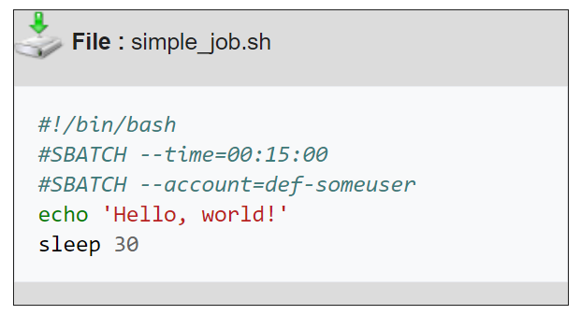
Automatic launching
How to launch automatic jobs ?
Compiling instructions in a bash file (.sh)

Slide 22
Automatic launching
Compiling instructions in a bash file (.sh)
sbtach instructions same as salloc command, but as header
--account=account
--time=time
--gpus=[type:]<number>
--mem=<size>[units]
--mail-type=<type>
To know more about slurm : https://slurm.schedmd.com/sbatch.html

Slide 23
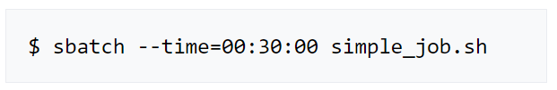

Automatic launching
Command line to launch the job
Output in ascii file located at :

Slide 24
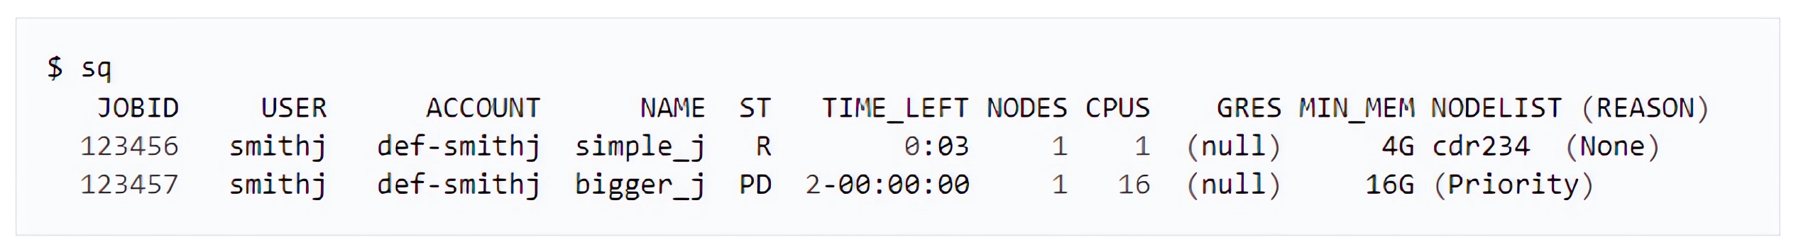

Managing current jobs
Command to look at your current job list, sq :
Canceling target job, scancel :

Slide 25

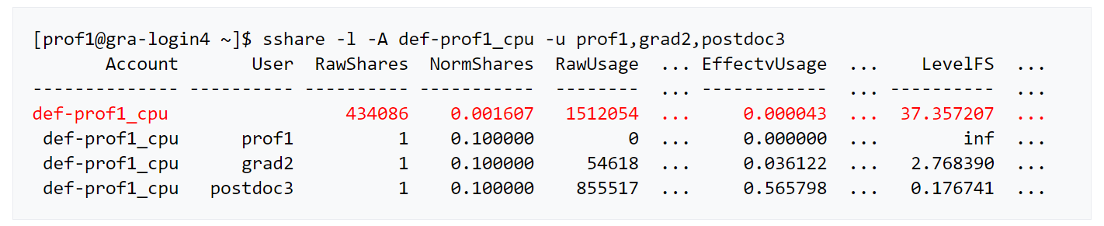
Why is my job still pending ?
Viewing ressource usage and priority on CC, sshare :

Slide 26
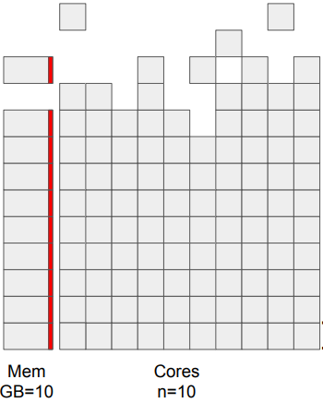
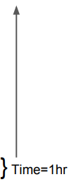
Why is my job still pending ?

Slide 27
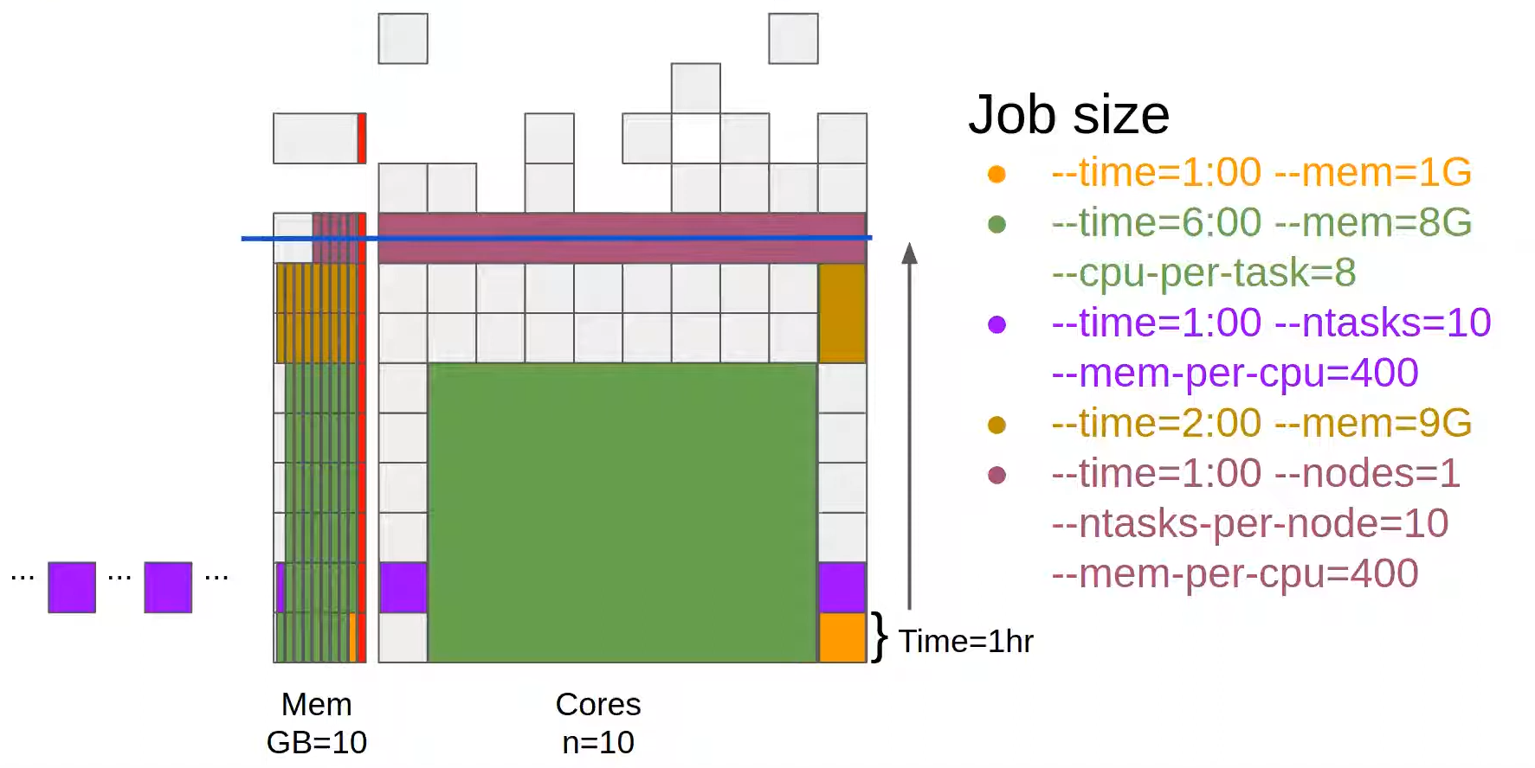
Why is my job still pending ?

Slide 28
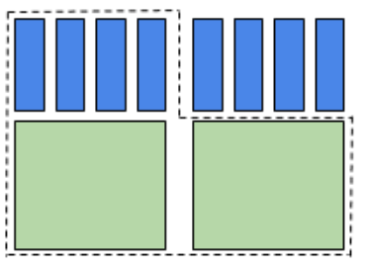
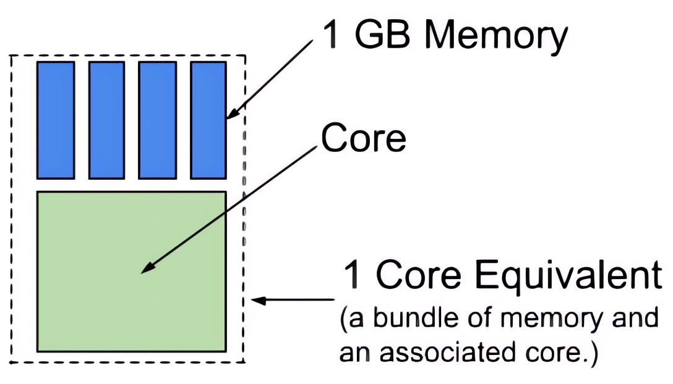
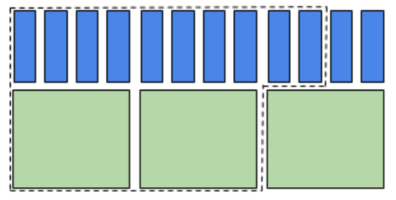
CPU account billing : CPU-equivalent
Exemple 1 :
Bill : 2 core-eq
Exemple 2 :
Bill : 2.5 core-eq

Slide 29
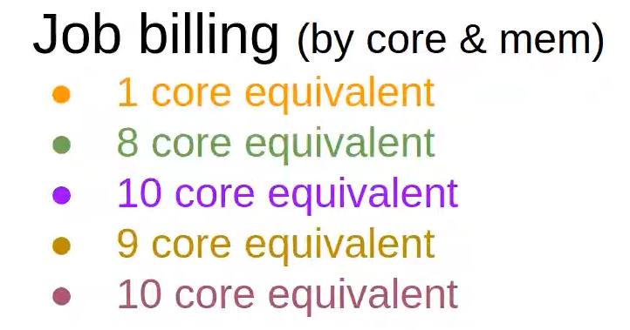
Why is my job still pending ?

Slide 30
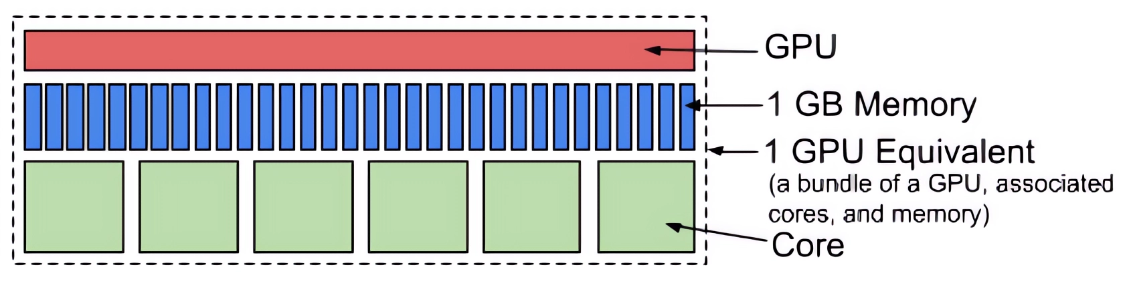
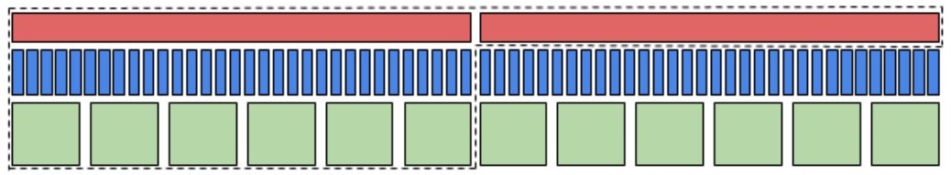
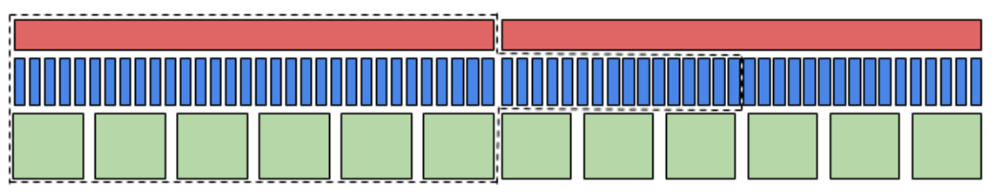
GPU account billing : GPU-equivalent
Exemple 1 :
Bill : 2 GPU-eq
Exemple 2 :
Bill : 1.5 GPU-eq

Slide 31
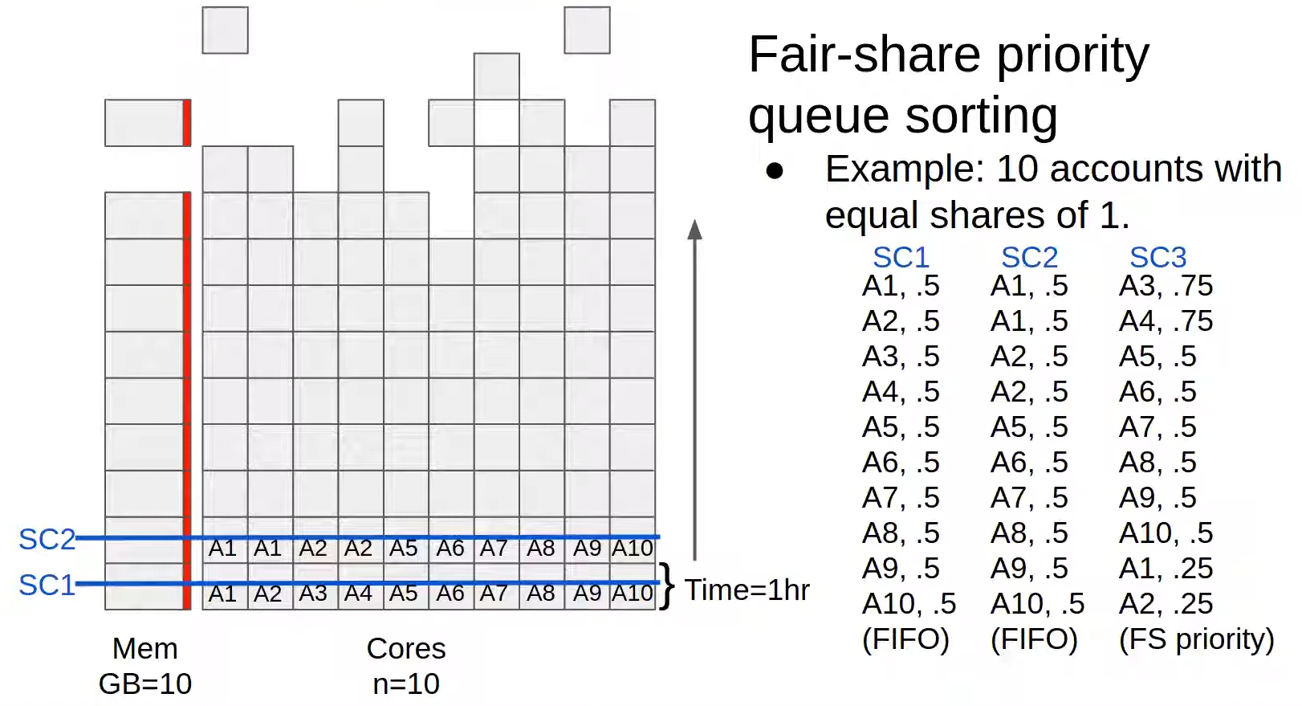

Slide 32
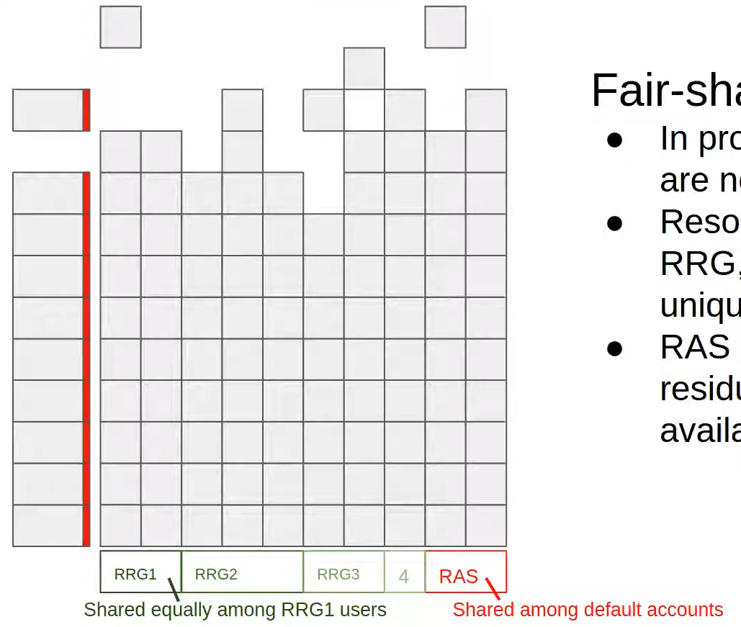
Resources allocations
Fair-share targets
In production target shares are not equal
Resource allocations (e.g. RRG, RPP) are defined by unique share targets.
RAS is the equally shared residual system resources
RAS is available beyond allocations

Slide 33
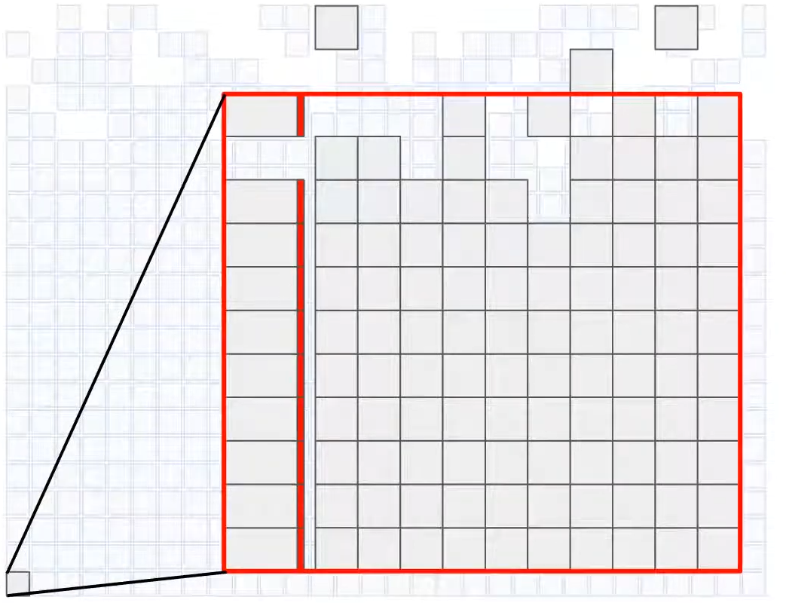

Slide 34
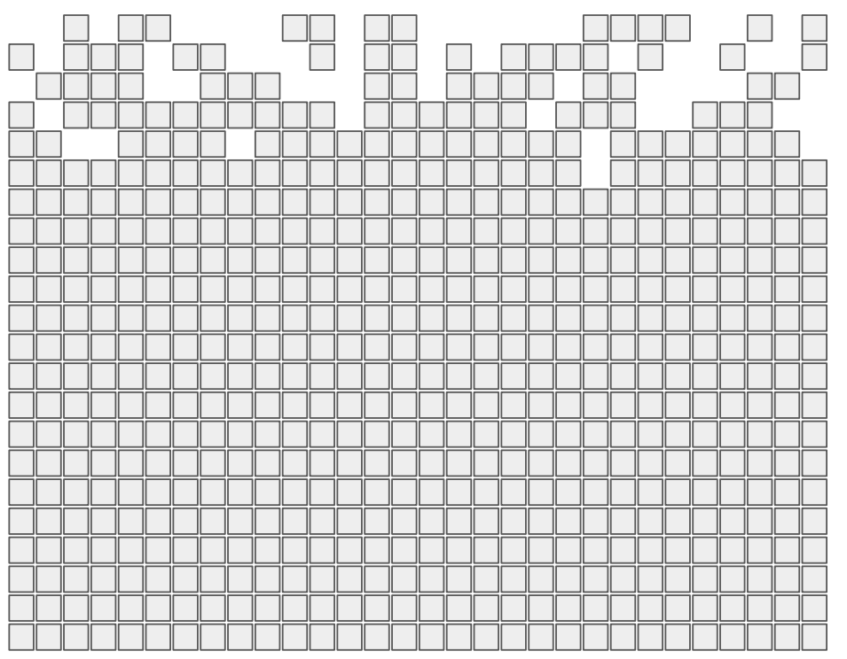

Slide 35
Backfill
By core
GPU
Long mem.
12 hours
3 hours
1 day
3 days
7 days
28 days
Medium memory
Int.
Base nodes
Special nodes

Slide 36
Backfill
By core
Partitions
Restrict jobs of specific shapes to node sets
Full node jobs can run on most any node (bynode)
Jobs 24 hours and shorter can run on most any node
Longer run time jobs have access to fewer nodes
Partial node jobs (bycore) have access to fewer nodes
Backfill jobs can run on most any node
GPU
Long mem.
12 hours
3 hours
1 day
3 days
7 days
28 days
Medium memory
Int.
Base nodes
Special nodes

Slide 37
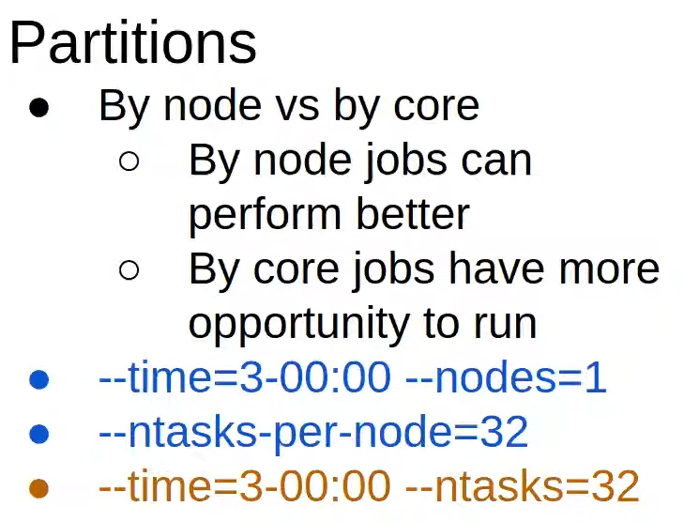
Backfill
By core
GPU
Long mem.
12 hours
3 hours
1 day
3 days
7 days
28 days
Medium memory
Int.
Base nodes
Special nodes

Slide 38
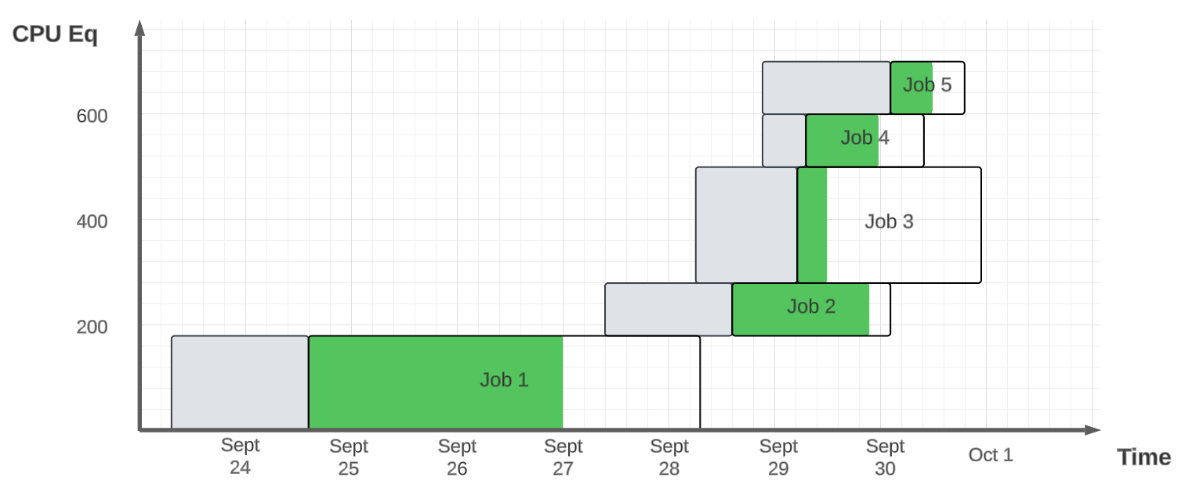
X CPU-eq/year (DISTRIBUTED on the year)
Job 3 ressource reservation : 200 CPU-eq
Job 1 time reservation : 4 days
Job queued
Job started
Job ended

Slide 39
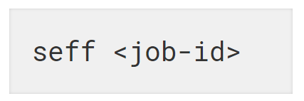
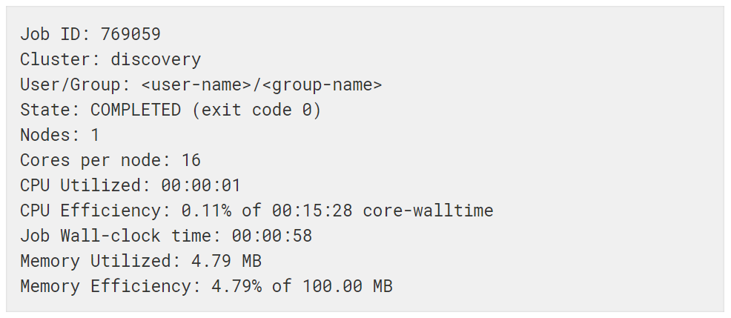
Job efficiency analysing
Command line to launch the job, seff :
Output :

Slide 40

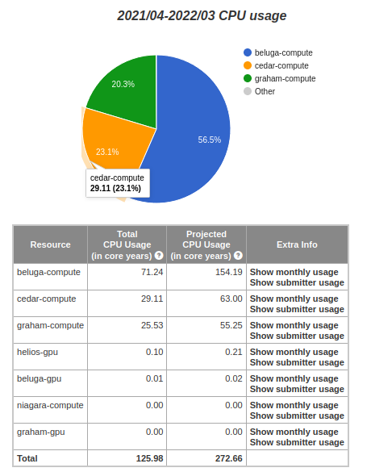
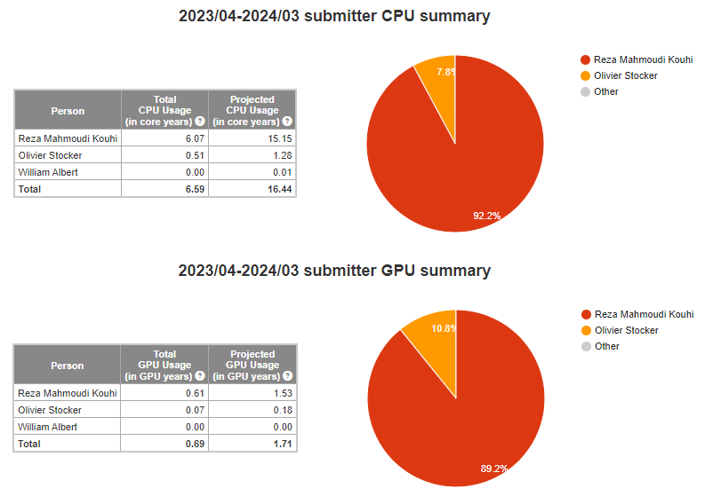
Group usage monitoring

Slide 41
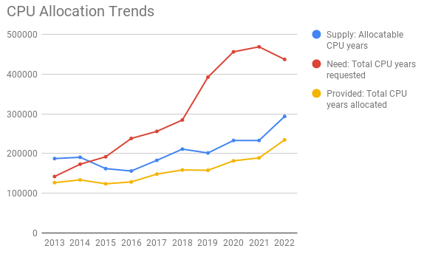
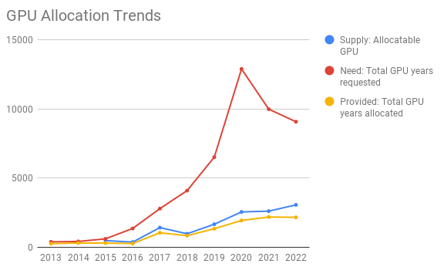
NEED MORE POWER !
Ressource allocation competitions (RAC):
Every year in fall (date varies, see website : alliancecan.ca)
Requirements :
Scientific peer review
Technical review
Buying computing ressources :
Group have priority on usage over purchased ressources
Maintenance done by DRAC
Price range depends on needed ressources ($10K up to $50K for multiple GPUs and/or a substantial amount of memory: 6 to 8 GB per core)

Slide 42
CC support for further details
Wiki page https://docs.alliancecan.ca/wiki/Technical documentation
Your coworkers !
Ticketing system via support@tech.alliancecan.ca

